Slide 1
Indoor Visual Positioning Aided by CNN-Based Image Retrieval: Training-Free, 3D Modeling-Free
Yujin Chen 1 , Ruizhi Chen 1,2,* , Mengyun Liu 1 , Aoran Xiao 1 , Dewen Wu 1 and Shuheng Zhao 1
Laboratory of Information Engineering in Surveying, Mapping and Remote Sensing (LIESMARS), Wuhan University, China;
2020-06-05
SKKU Yang Yong Jun

Slide 2
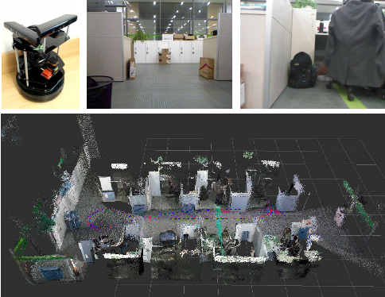
1. Visual Positioning - Localization
Indoor localization is a technology used for indoor navigation and spatial recognition of robots.
Create a 3D map of the environment based on the image.
Based on the camera image, it determines which direction the robot is looking at from where on the map. (position, orientation)
reference

Slide 3
2. Abstract
The problem of indoor visual localization is trade-off of accuracy and cost.
Paper proposed localization method based on image retrieval with two steps.
CNN-based image retrieval phase CNN features extracted by pre-trained CNN (VGG16, ResNet) images are utilized to compare the similarity, and the output of this part are the matched images of the target image.
Pose estimation phase that computes accurate localization result The pose estimation scheme was inspired by monocular visual odometer, therefore, only RGB images and poses of reference images are needed

Slide 4
3. Main Contribution
Image-based visual positioning scheme is proposed.
Proposed method recover camera pose from two sets of 2D-to-2D matches.
Because the pre-trained CNN model is used, there is no need to learn about different environments.
Uses a lighter model because it uses a DB extracted from CNN features

Slide 5
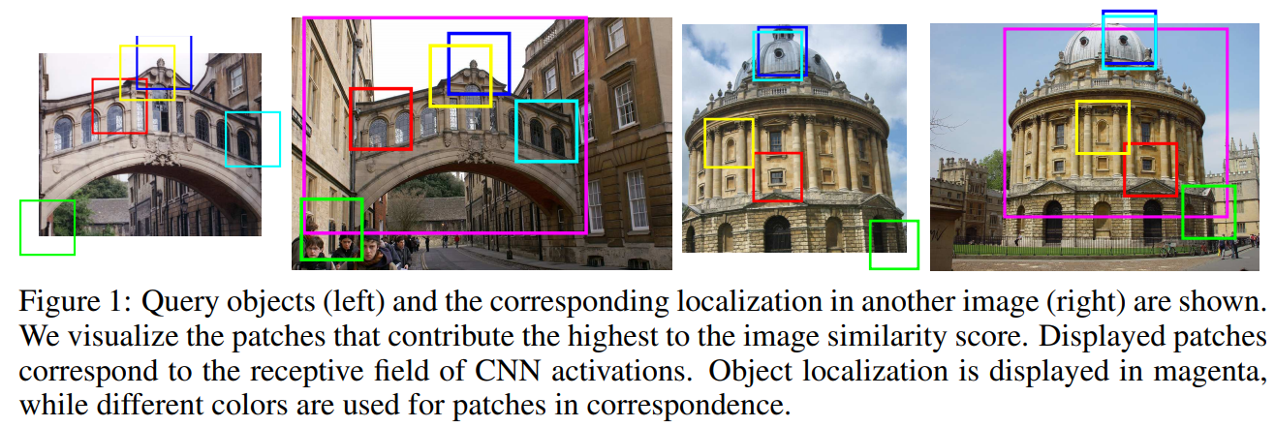
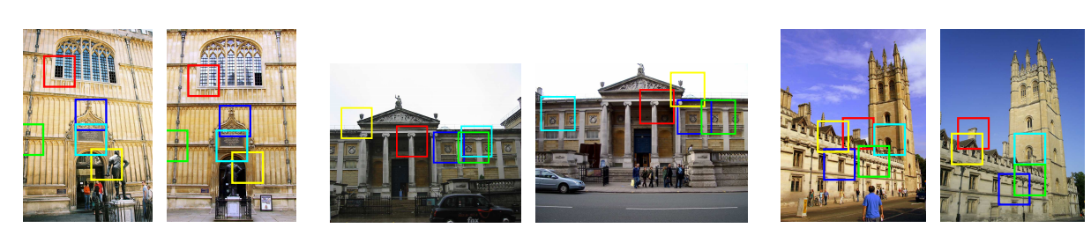
4. Deep Image Retrieval
Objective: Take an image as a query and search for a similar image.
We can even consider finding similar images using the same image or even semantic information.
Finding similar images in large image datasets ex) Google Image Search, Localization in City
https://arxiv.org/pdf/1511.05879v1.pdf

Slide 6
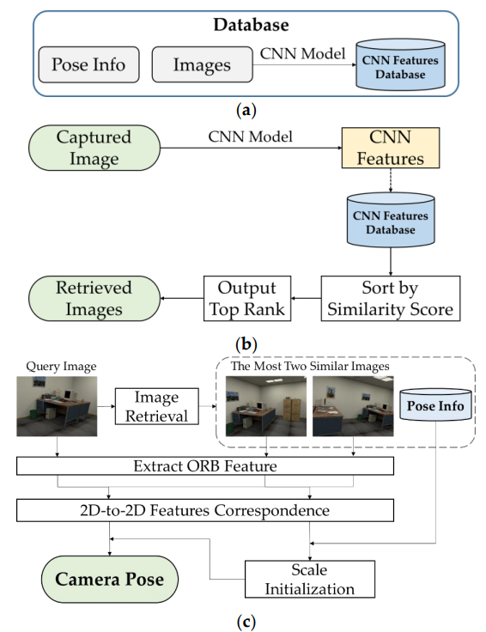
5. System Architecture
(a): Database Construction (b): Image Retrieval (c): Pose Estimation
A: We collected RGB images from target scenarios, then extracted CNN features through pre-trained CNN models.
B: Ranked similarity between image from database and CNN features extracted from captured image.
C: Pose Estimation of query image and similar images. Extract ORB Feature and Calculate 2D-to-2D Correspondence

Slide 7
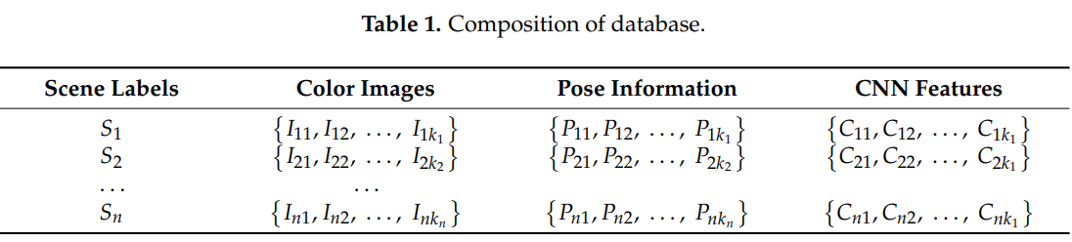
5.1 Database
Database was stored
Color Image (WxH)
Pose Information (x, y, z, orientation)
CNN Feature from pretrained Network

Slide 8
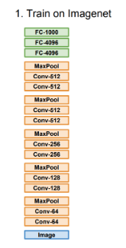
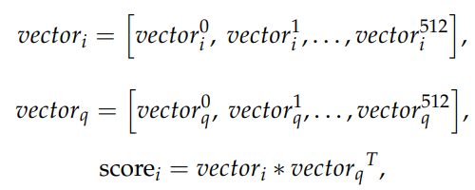
5.2 Image Feature
Extract the features vector of the pre-trained image from the input image
Find similarity score between it and DB’s feature vectors
The similarity score can be used to find the image most similar to the input image.

Slide 9
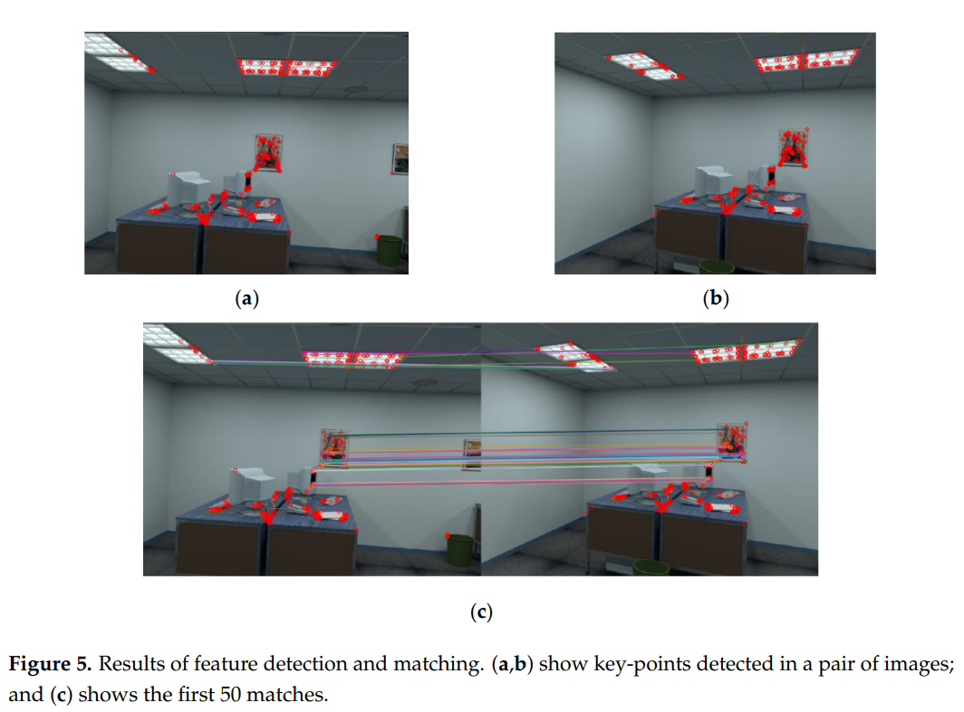
5.3 Pose Estimation
Key point matching with query & DB image
Extraction of ORB features from a pair of images,
We use Hamming distance as distance measurement to match features

Slide 10
5.3 Pose Estimation
RGB images' features are correspond to 2D space.
DB Images have pose information
Input’s orb feature: F_{q} , DB’s orb feature: F_{db}
Goal: F_{q} = T₁ * F_{db} Pose_{q} = T₁ * Pose_{db}
2D-to-2D’s geometric relationship

Slide 11
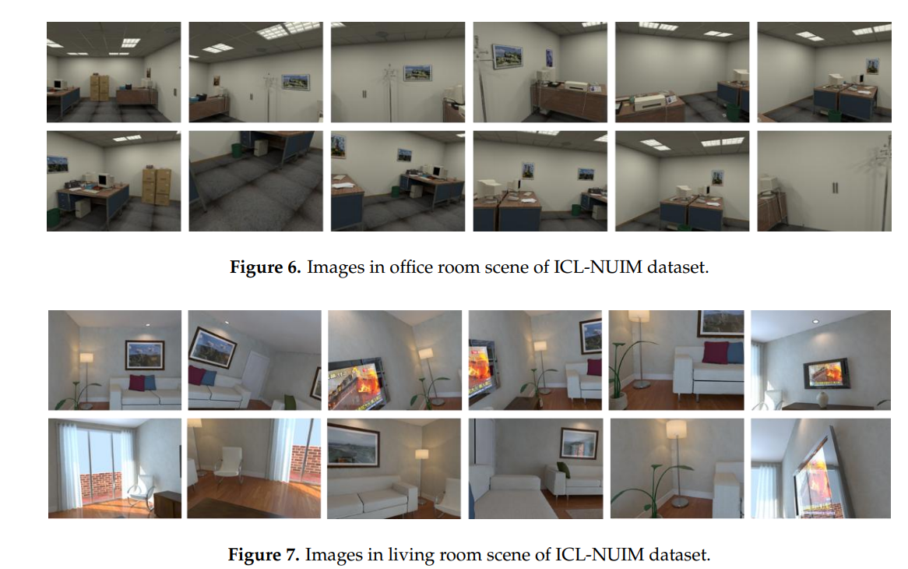
6. Experiment

Slide 12
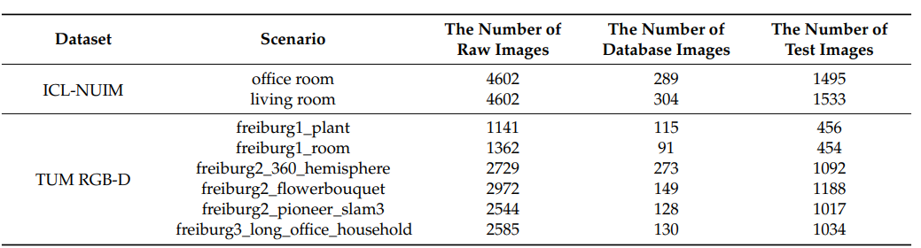
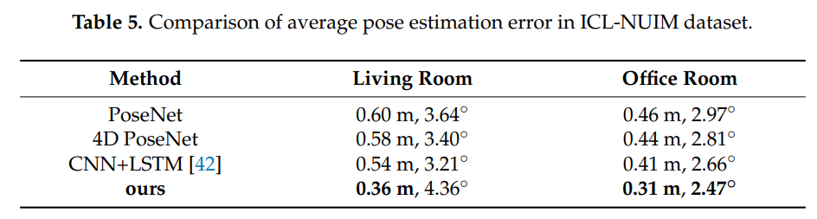
6. Experiment

Slide 13
7. Conclusion
We utilize a CNN-based image retrieval strategy which represents the scene by CNN features, and match the query image with database images.
After that, the pose of the query image is recovered from the ORB feature points’ correspondence
CNN-based image retrieval strategy and RGB images for accurate localization which is highly applicable to monocular vision positioning task.

Slide 14
Discussion - Opinion
Higher performance can be achieved when learning using the target environment image.
Rather than get features for the entire image, picking features for landmarks will improve performance. (Attention score)

Slide 15
Thank you

